Slide 1
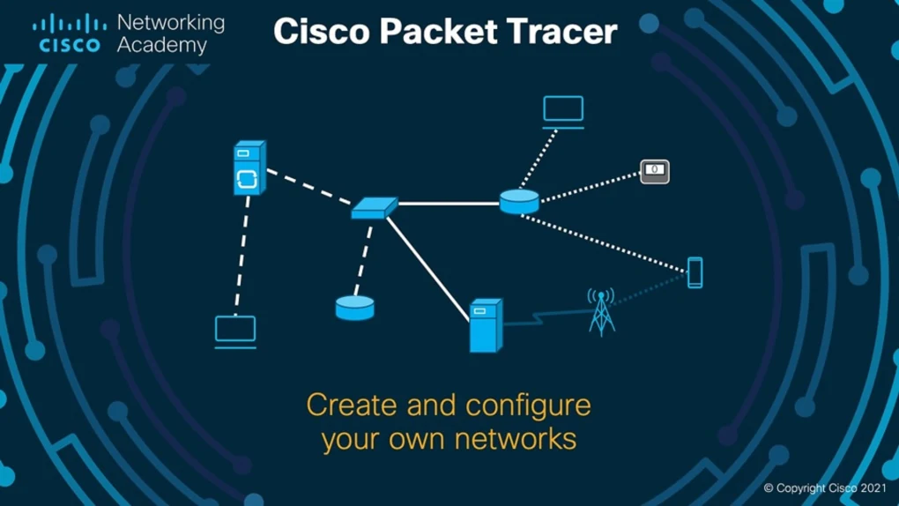

Slide 2
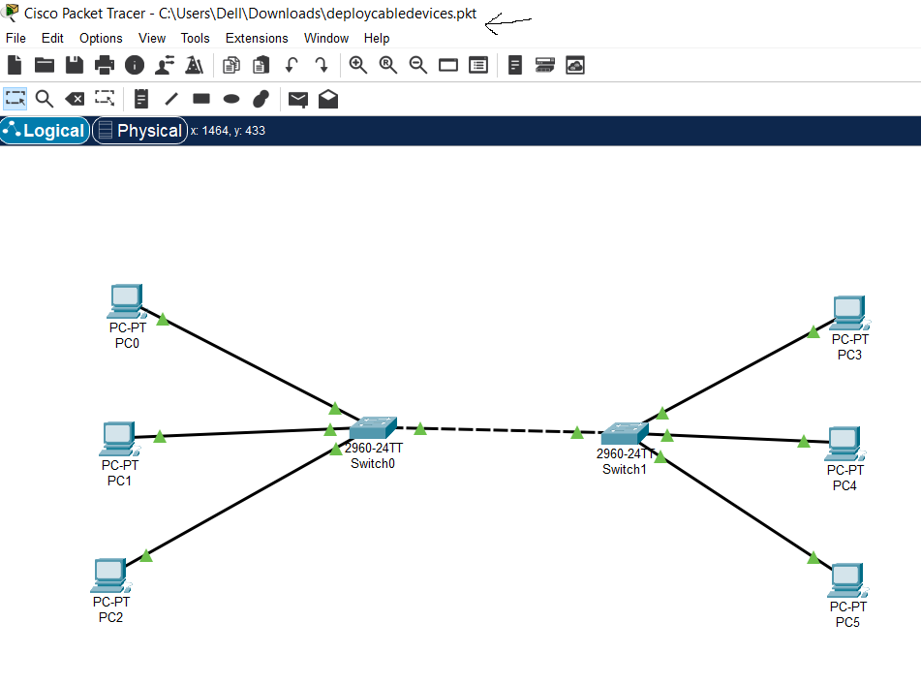
What is Cisco Packet Tracer?
Cisco Packet Tracer is a network simulation tool used to design, configure, and troubleshoot networks.
It provides users with a cost-effective and safe way to experiment with different network designs and configurations.

Slide 3
Features of Cisco Packet Tracer
Simulation of network devices | Provide simulation for a wide range of network devices, including routers, switches, and servers
Creation of network topologies | Allow users to create custom network topologies by using various network devices and connecting them together.
Configuration and troubleshooting of networks | Provide a real-life environment to configure and troubleshoot networks, allowing users to practice real-world scenarios.

Slide 4
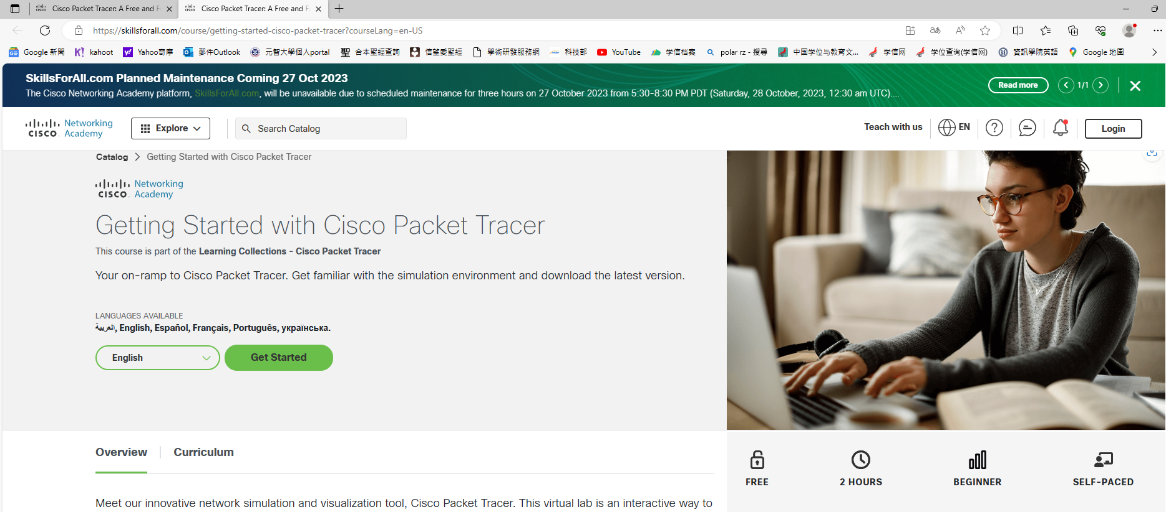
Getting Started with Cisco Packet Tracer
Download and practice along with the tutorial material.
https://skillsforall.com/course/getting-started-cisco-packet-tracer?courseLang=en-US

Slide 5
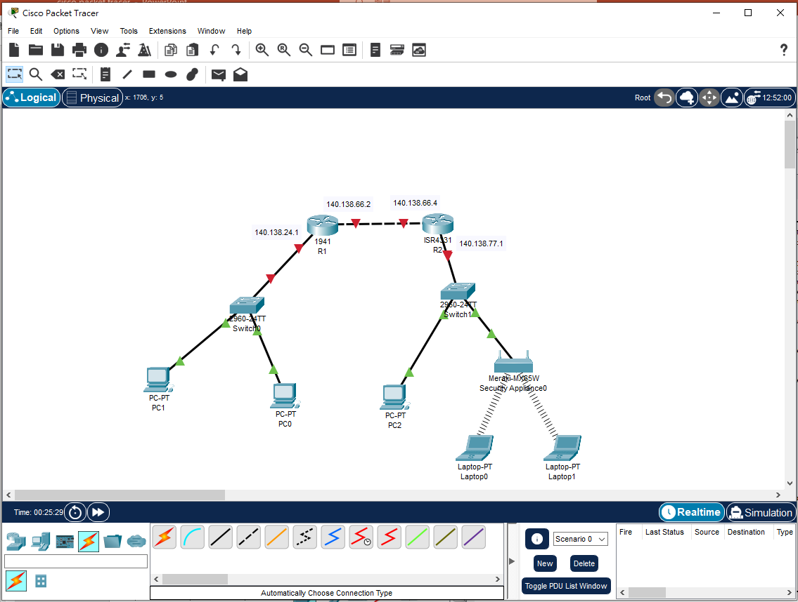
Network
Topology
View

Slide 6
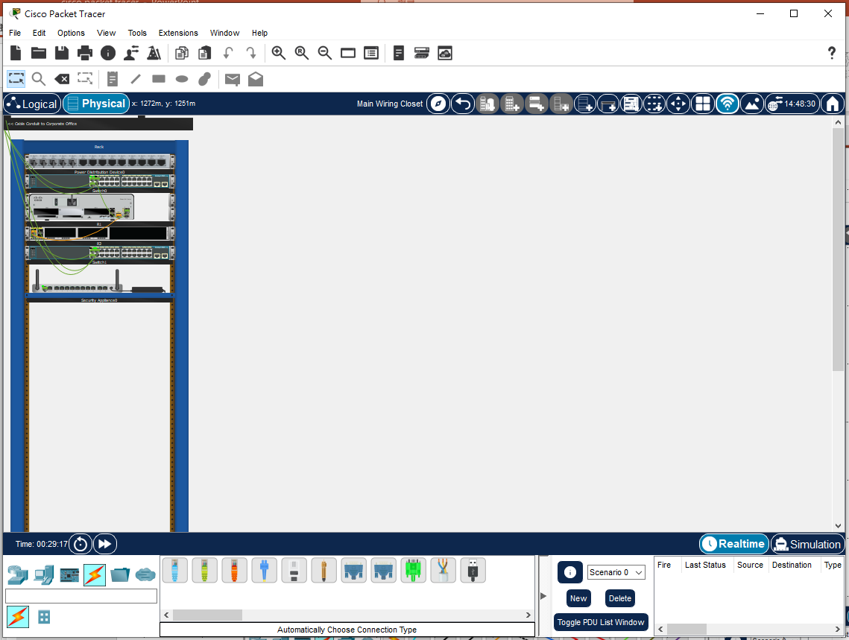
Network
Topology
View

Slide 7
Working
Area

Slide 8
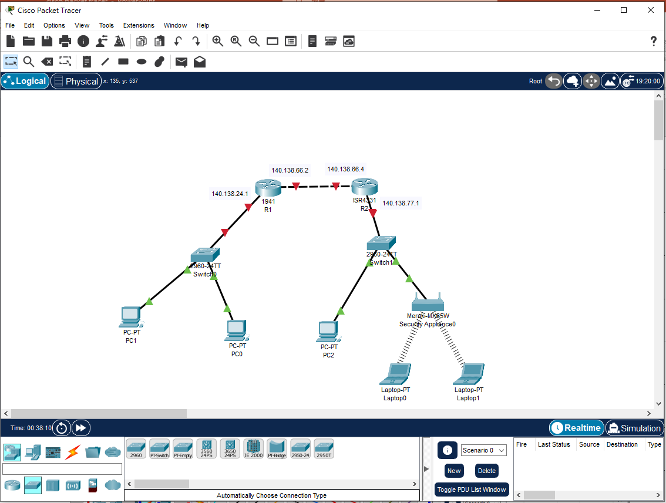
Network
devices
Switch type

Slide 9
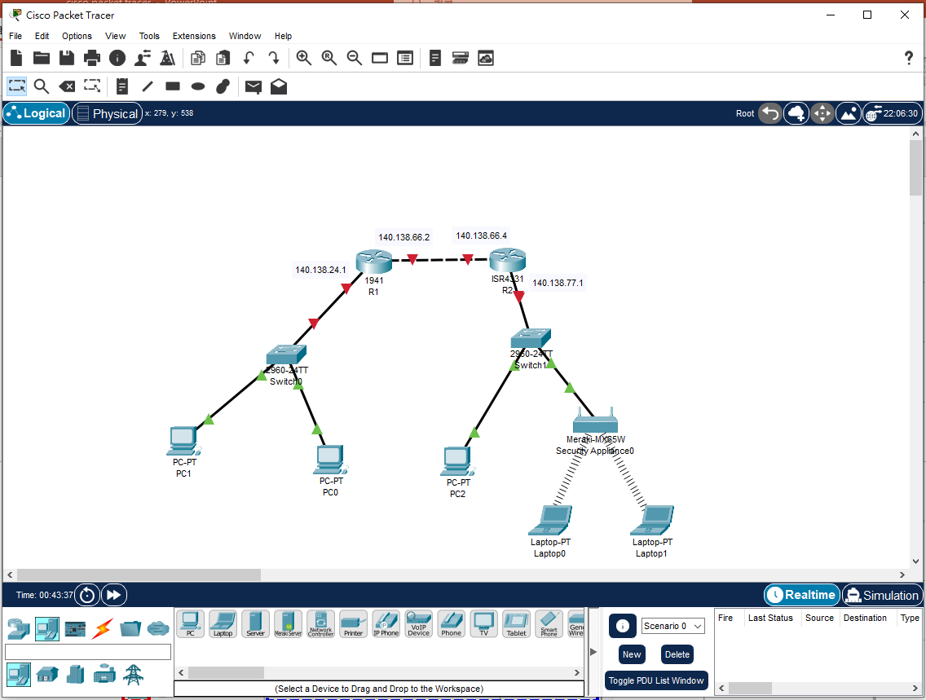
End
devices
Computing
Devices

Slide 10
Device
Types
Connection
Types

Slide 11
Editing
Tools
Comment

Slide 12
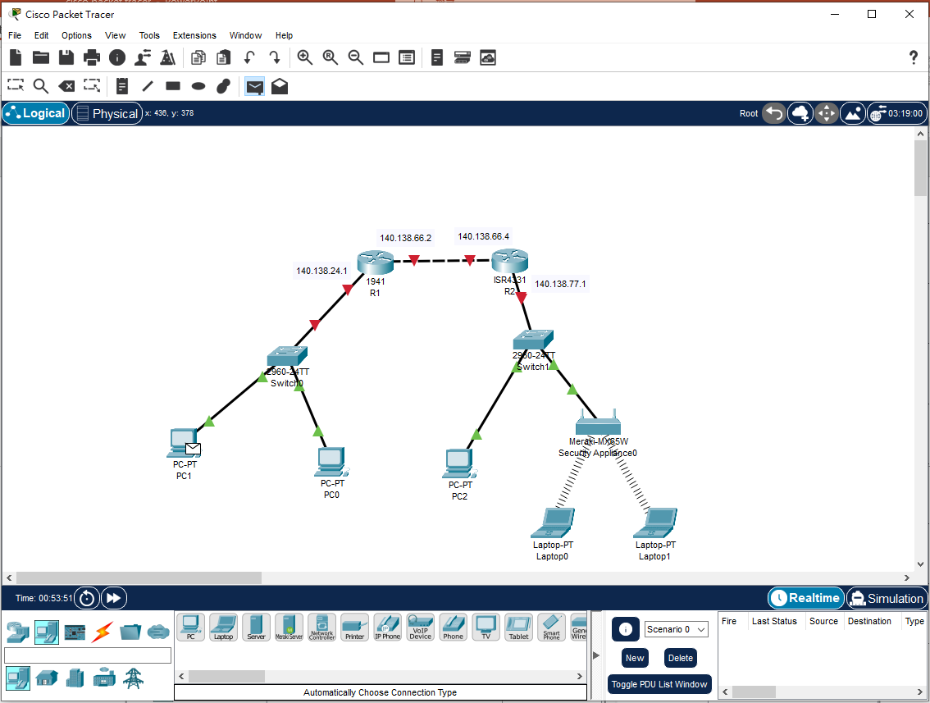
Editing
Tools
Packet Unit

Slide 13
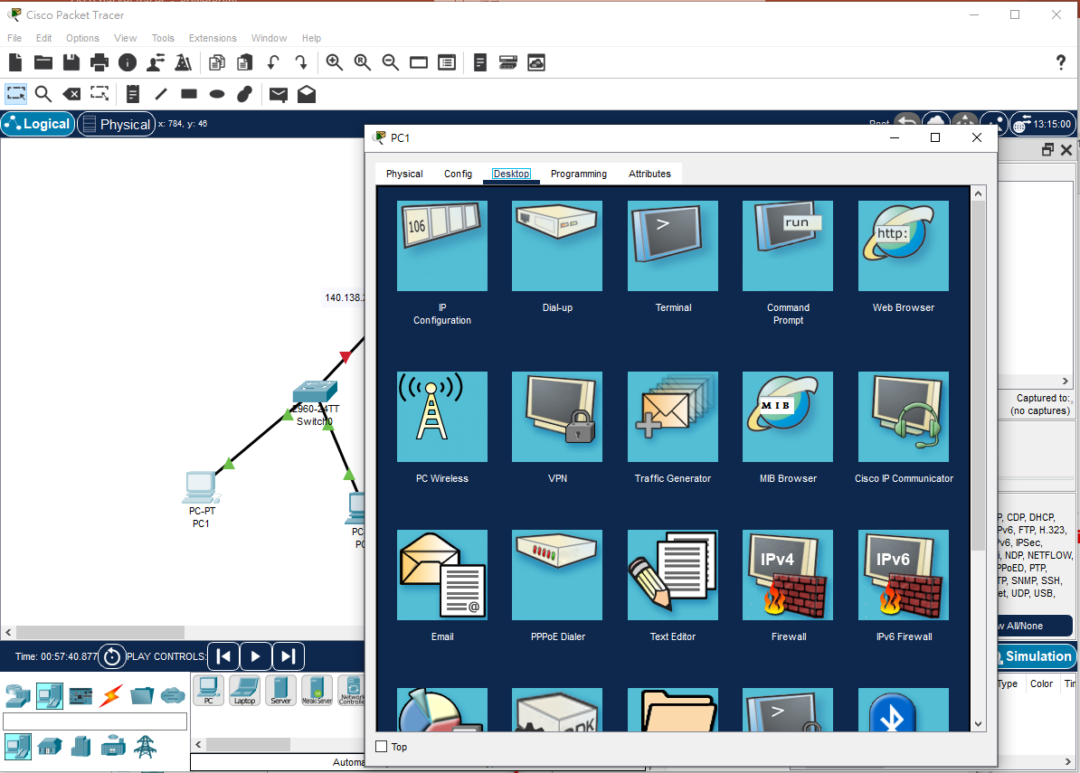
End device Tools
Desktop

Slide 14
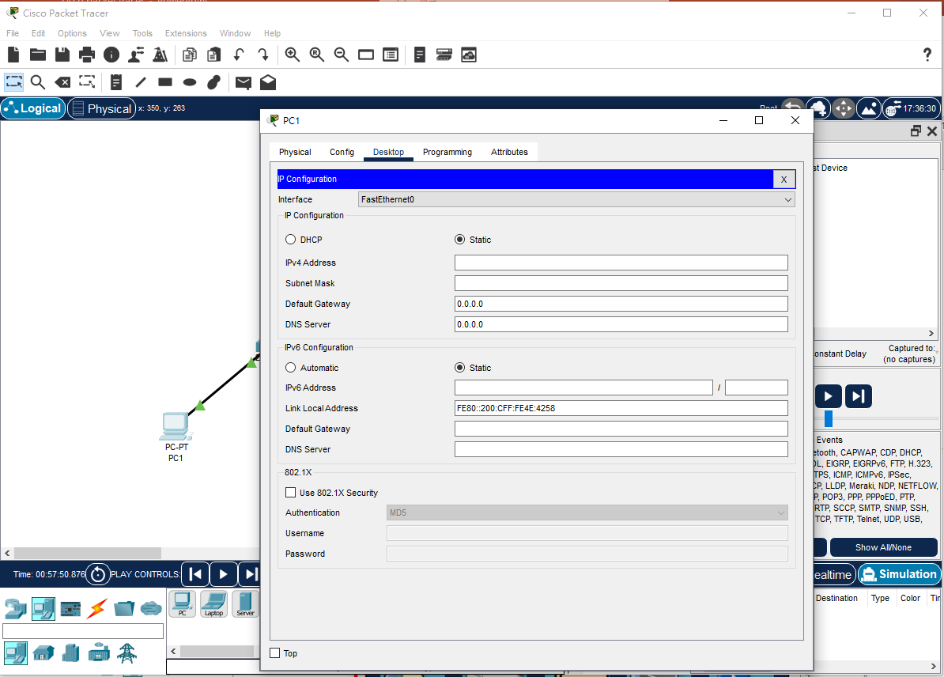
End device Tools
End device
configuration

Slide 15
Issue commands like in PC
Desktop

Slide 16
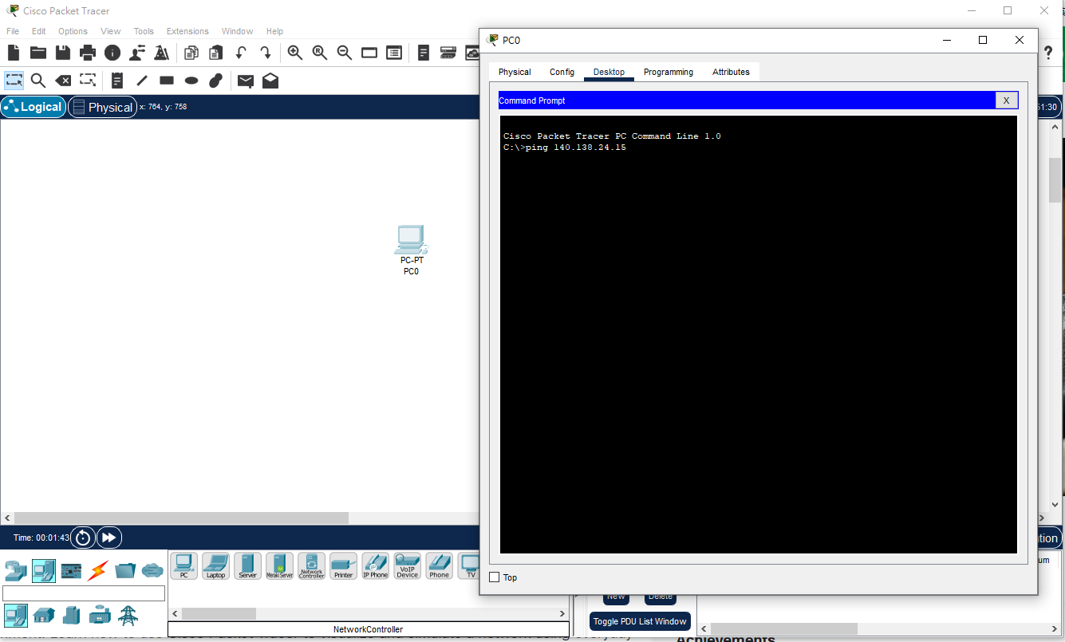
Command PING

Slide 17
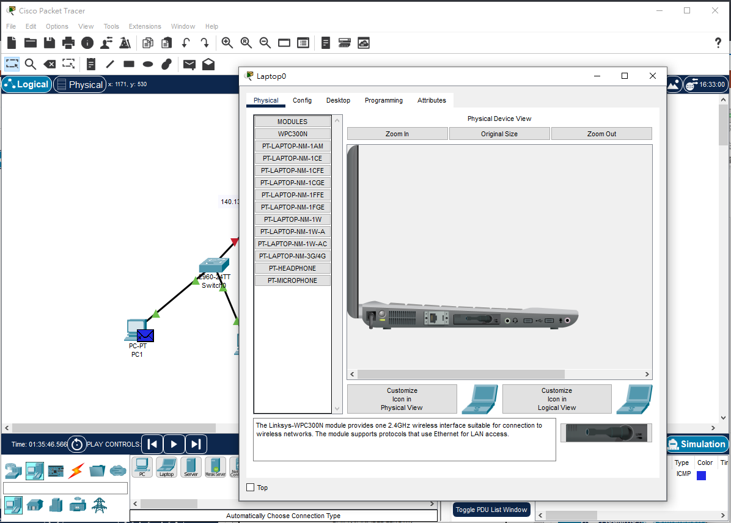
Choose Physical
For LapTop
Wireless module
Default is Ethernet
UnPlug Ethernet &
Plug WPC300N
Power off
Before replace
WPC300N

Slide 18
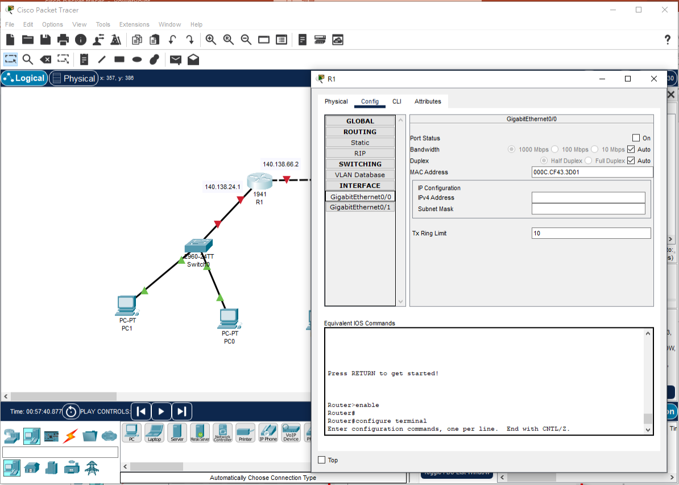
Router Configuration
Port
Configuration

Slide 19

Port Configuration
Turn the port
On
Port IP@
configuration

Slide 20
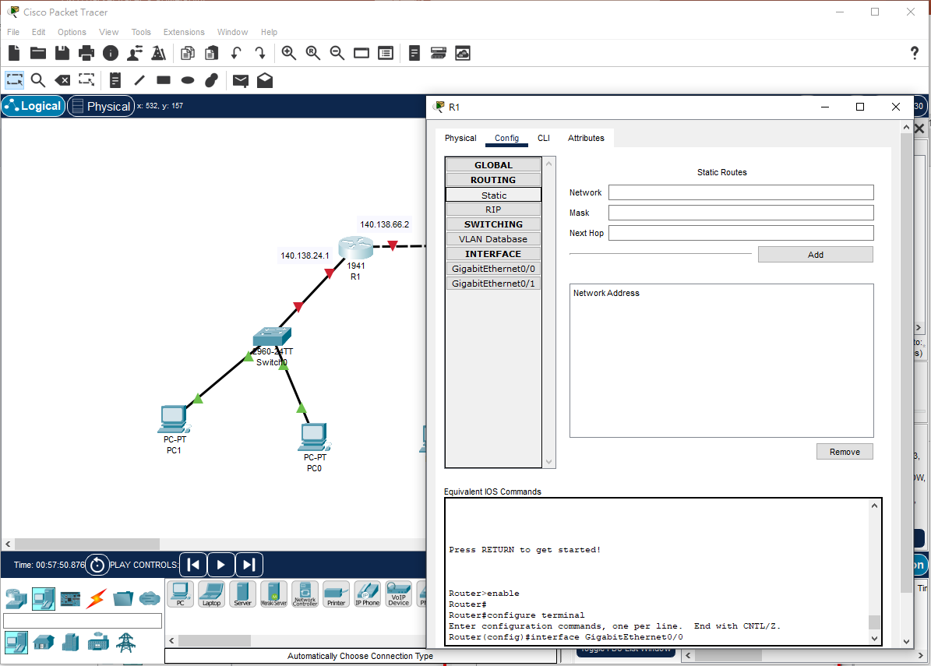
Routing configuration
Destination address
Next hop IP@
Routing Table

Slide 21
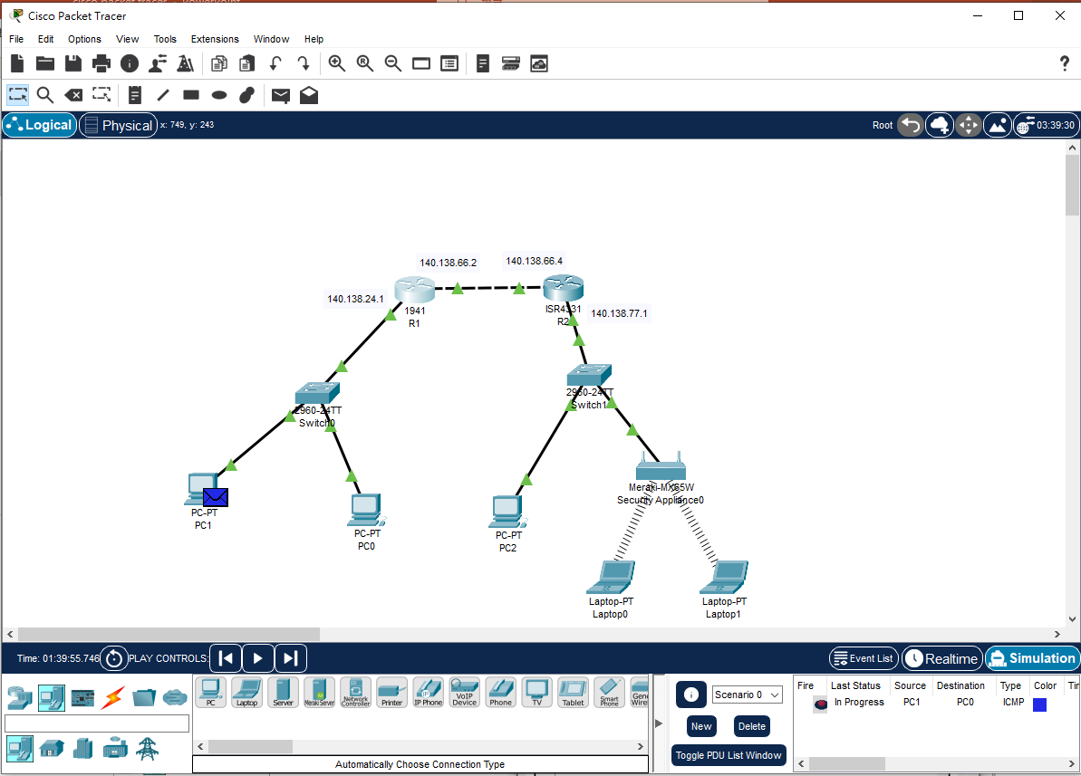
All links are green
When they work

Slide 22
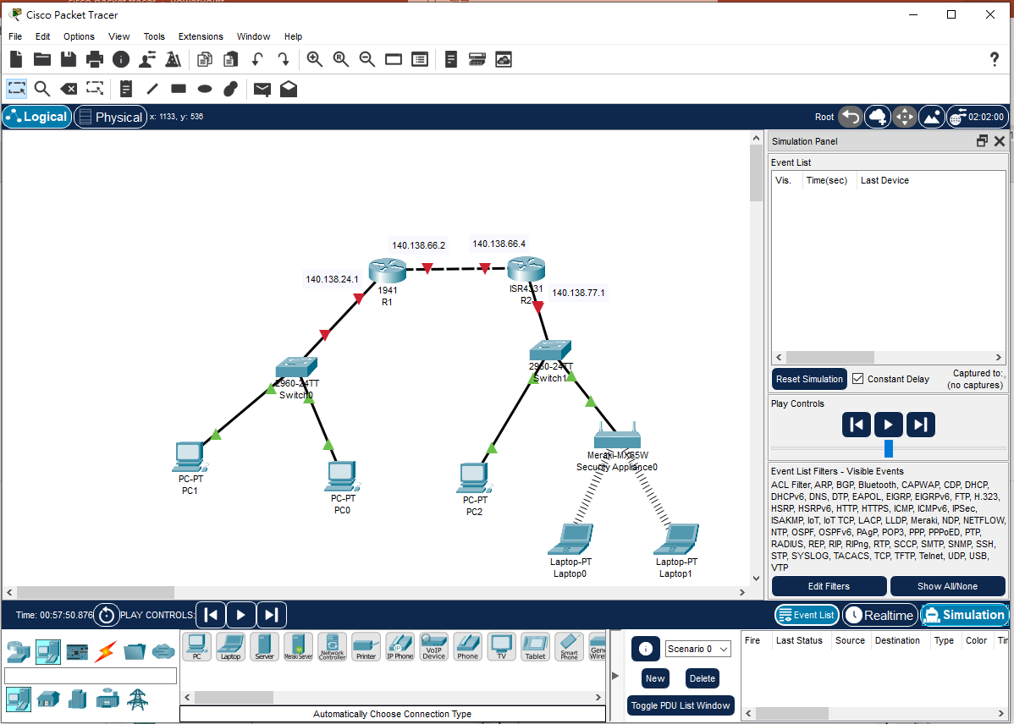
Events
Simulation playback
Filter setting
Simulation

Slide 23
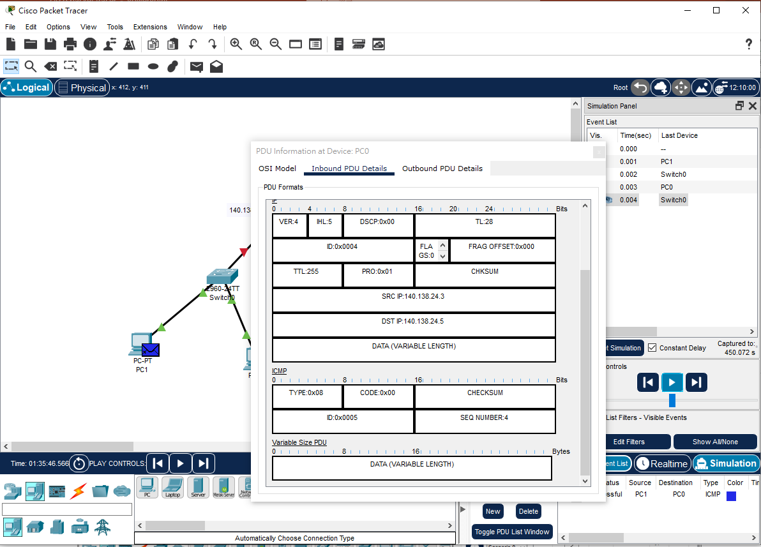
PDU format
IP
Header
Click on PDU
ICMP
Header

Slide 24
Configure a default gateway using interface fa0/0 for our LAN with command mode.
Router>enable Router#config terminal Router(config)#int fa0/0 Router(config-if)#ip add 192.168.1.1 255.255.255.0 Router(config-if)#no shutdown Router(config-if)#exit

Slide 25
Configure DHCP server on the Router
In the server we will define a DHCP pool of IP addresses to be assigned to hosts, a Default gateway for the LAN and a DNS Server.
Router(config)# Router(config)#ip dhcp pool MY_LAN Router(dhcp-config)#network 192.168.1.0 255.255.255.0 Router(dhcp-config)#default-router 192.168.1.1 Router(dhcp-config)#dns-server 192.168.1.10

Slide 26
Reserve addresses that are statically assigned to key hosts
Use ip dhcp excluded-address command
So add the above command under the global configuration mode.
Router(config)#ip dhcp excluded-address 192.168.1.1 192.168.1.10

Slide 27
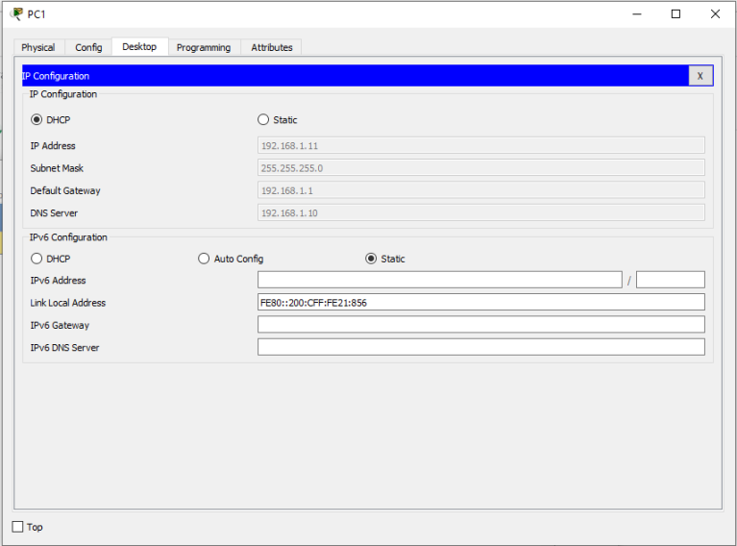
Enable DHCP in every PC on their IP configuration tabs

Slide 28
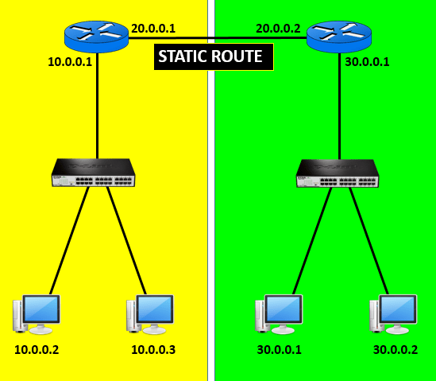
List of things to remind
In the static mode, all IP addresses and routing table must be configured manually. No DHCP server is needed.
In the dynamic mode, a DHCP server must be configured in a router or deployed separately.
Ping among end devices to check if all your setting is correct.

